Slide 1

Energy Community
Case Study
Economics & Smart Management of electrical systems course.

Slide 2
Program
01
02
03
04
Optimization problem
Energy Community
Management problem definition
Optimization problem development
General overview
Case Study Introduction
Results
Economic feasibility
Simulations discussion and results
Analysis feasibility
Conclusions

Slide 3
01
Renewable
Energy community
Brief overview

Slide 4
What does Renewable Energy Community mean?
It is an association that produces and shares renewable energy, generating and managing cost-effective green energy autonomously, reducing CO2 emissions and energy waste.
The community may be composed of local citizens, businesses, public administrations, small and medium-sized enterprises, etc.
The main goal is to provide community-based environmental, economic or social benefits to its shareholders or members or to the local areas in which it operates.

Slide 5
General Overview
History
The term CER was first introduced by the "Renewable Energy Directive 2018/2001" (known as RED II), published in December 2018. In Italy, the transposition of the directive took place with Article 42-bis of the 'Decreto Milleproroge' first, in its implementing measures (ARERA's Resolution 318/2020/R/eel and MiSE's DM September 16, 2020) and in Legislative Decree 199/2021 then.
Constrains
CER members must be on the low-voltage or medium-voltage networks, underlying the same primary substation (HV/MV).
Each plant Power ≤ 200 kW & of new generation
Total Power ≤ 1000 kW for incentives access

Slide 6
General Overview
Benefits
Return of some tariff components according to a remuneration of network charges
Shared energy incentive established by MiSE;
Energy fed into the grid (by each plant) remuneration, excluding physically self-consumed share, at the hourly zonal price.
Various aspects
Need for a Statute within relationships among members are regulated and benefits distribution criteria is defined.
Ability to access markets for dispatching services.

Slide 7
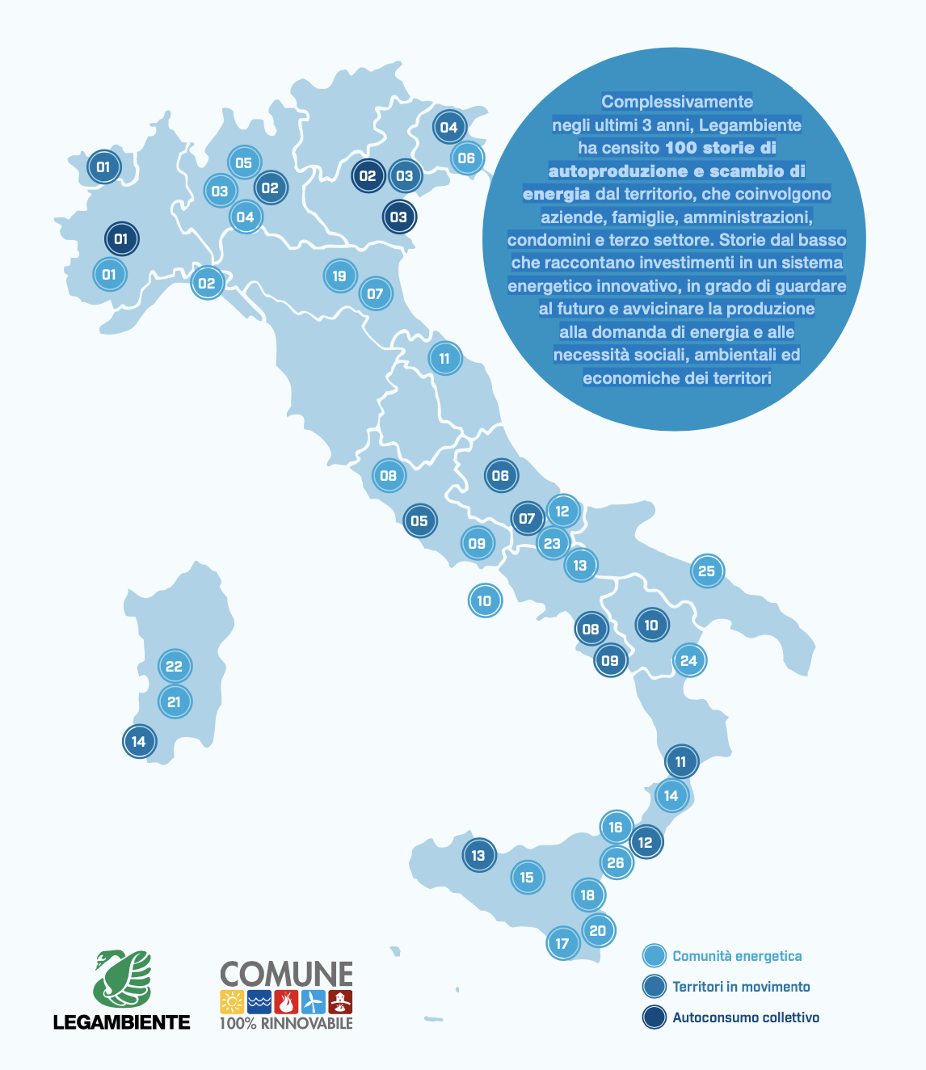
Application Cases in Italy
Overall over the past 3 years, Legambiente has surveyed 100 stories of self-production and exchange of energy from the territory, involving companies, families, administrations, condominiums and the third sector.
Stories from below that tell of investments in an innovative energy system that can look to the future and bring production closer to energy demand and the social, environmental and economic needs of the territories. We’ll show some examples.
Source: https://www.legambiente.it/wp-content/uploads/2022/05/Comunita-Rinnovabili-2022_Report.pf

Slide 8
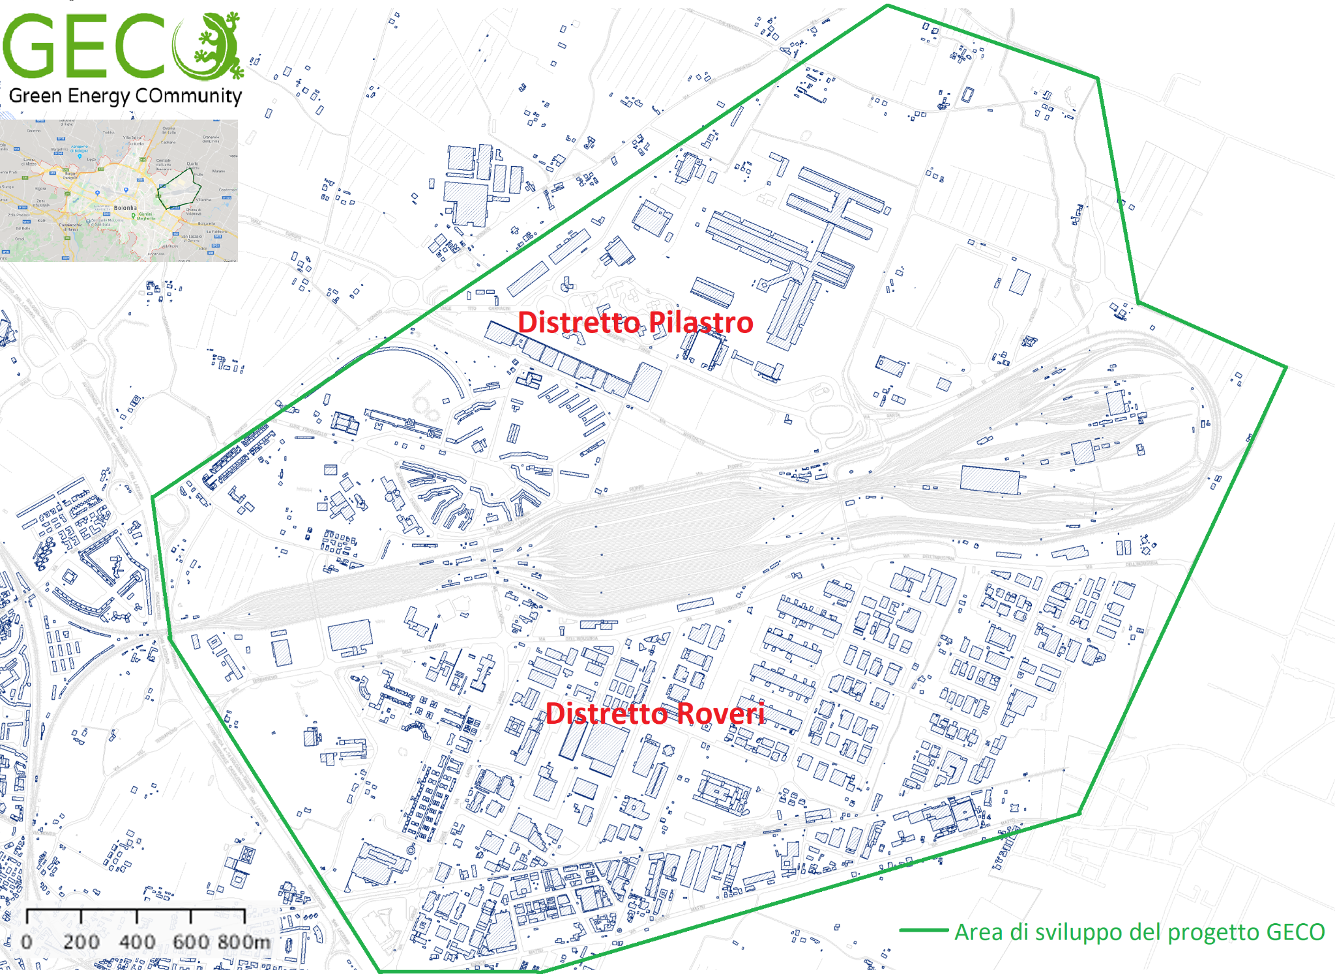
Application Cases in Italy
Link project: https://www.gecocommunity.it
Location: Pilastro e Roveri districts, Bologna.

Slide 9

Application Cases in Italy
Link project: https://www.fondazioneconilsud.it/progetto-sostenuto/comunita-energetica-e-solidale-di-napoli-est/
Location: San Giovanni a Teduccio, Napoli.

Slide 10
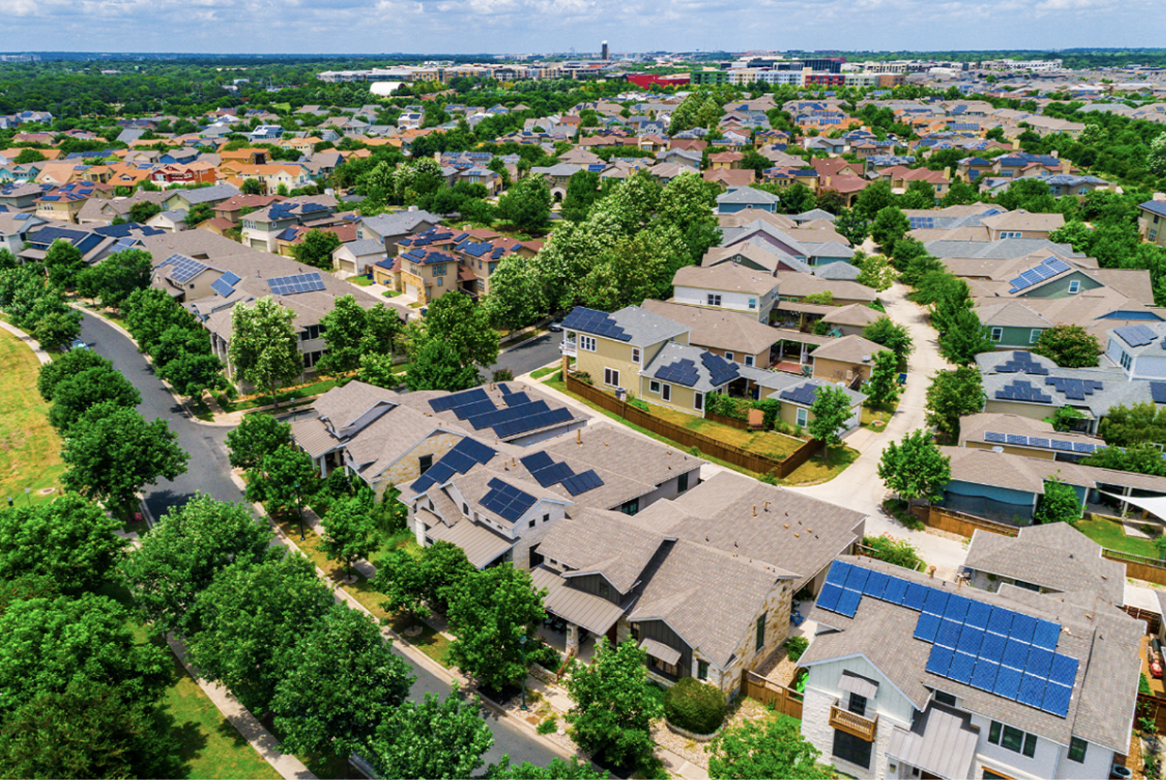
Application Cases in Italy
Link project: https://cermaglianoalpi.it
Location: Magliano Alpi, Torino.

Slide 11
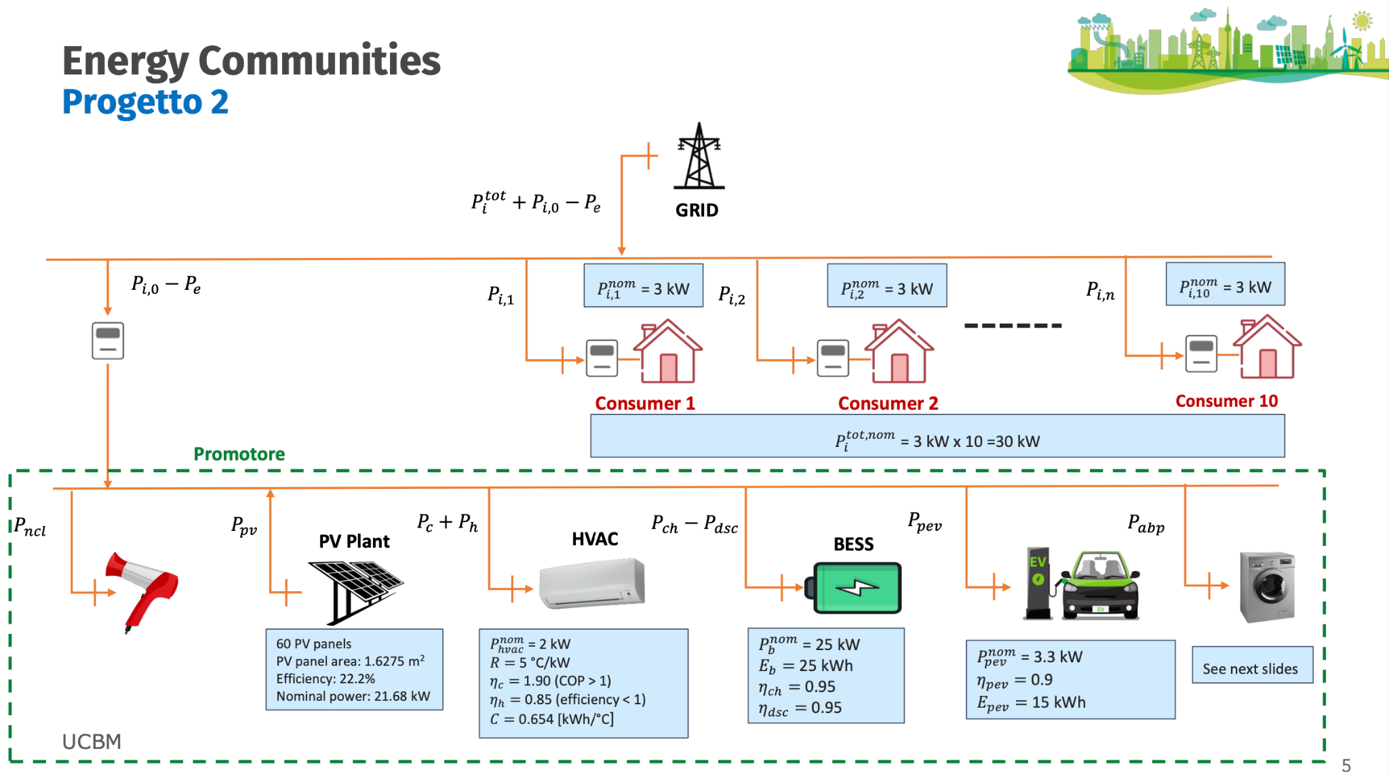
Case Study introduction

Slide 12
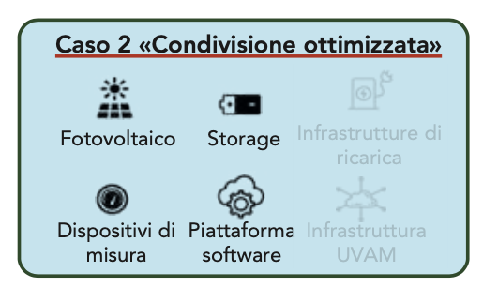
Case Study analysis
We assume a, simple and little, Renewable Energy Community made up of 10 households , for a total nominal power of 30 kw, and 1 Prosumer which it may be an hospital or an hotel.
The hypothetical hotel is characterized by: a Pv plant, a Battery Energy Storage System, an Heating and Ventilation Air Conditioning, an uncontrollable load, a washing machine (as appliance based on phases) and a Plug-in Electrical vehicle charger.
Given the community architecture, its technological configuration type is ‘2b premium’, optimized sharing, thanks to PEV presence that we assume bought by the community itself and not by a ‘third developer’.

Slide 13
02
Problem definition
Optimization problem definition Matlab and AMPL development

Slide 14
Problem definition
Optimization goals
minimize consumption costs and/or maximize energy community revenues
meet smart home user needs
maintain the temperature around the set-point value Tsp = 22°C with a tolerance of Δ = 2°C;
maintain battery State-of-Charge (SoC) in [0.1 0.9] range.

Slide 15
Problem definition
Assumptions
Pc, Ph can be set with continuity in the interval [0 Pnom];
T(k), Tex(k), Ppv(k), Pi-tot(k), SoC(k),Pul(k) are measured at k time;
Tex(k), Ppv(k),Pul(k) forecast are available for the next 24 hours;
cost of imported energy cl(k) is known for the next 24h (use ARERA prices);
price of exported energy Pe is known for the next 24h (use PUN);
shared energy Pc price is set at 119 €/MWh (MiSE incentive);
Time sampling interval Δ𝑡𝑠=1h;
User time requirements are declared; for any controllable load (PEV, HVAC, ABP), the user indicates in advice, the time interval within which the load can be switched on by setting to 1
UR𝑝𝑒𝑣(j) , UR𝑣𝑎𝑐(j) , UR𝑎𝑏𝑝(j) if the device can be switched on at the hour 𝑗;
for PEV the user declares the SoC to be reached: SoC*
for HVAC, the user declares the temperature set point Tsp(j) for each time interval in the next 24 hours;
for ABP, the user declares which program needs to be executed in the example we have a unique program with the following parameters: energy required to complete phase 𝑖, execution time of phase 𝑖 , maximum power of phase 𝑖, minimum power of phase 𝑖 and maximum delay before phase 𝑖:

Slide 16
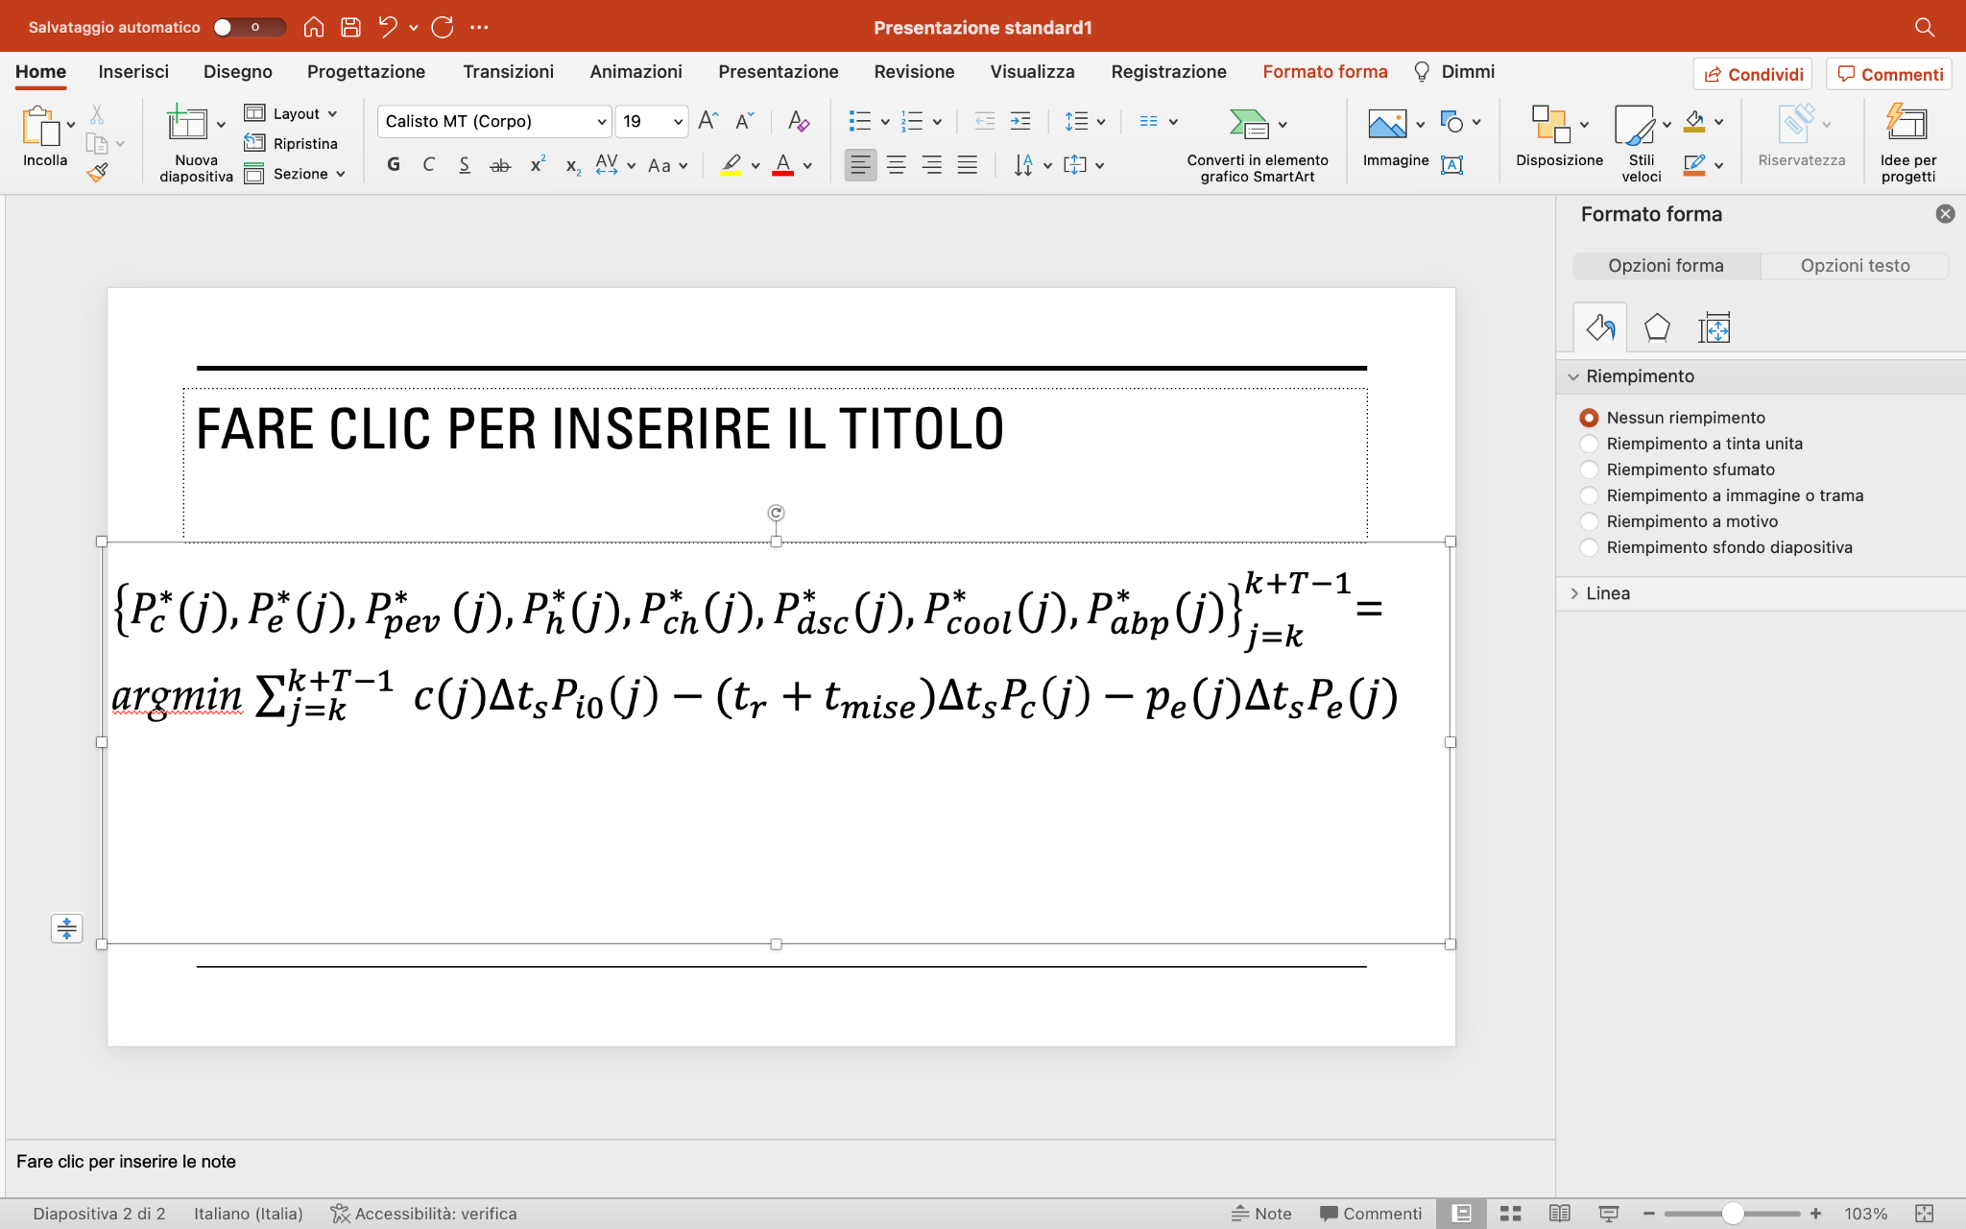
Problem definition
Cost function definition
Optimal control problem for a linear discrete-time system
Linear cost function
Pc(j) power shared by community;
Pe(j) power exported by prosumer;
Pi0(j) power consumed by prosumer;
Δts sampling time;
tr +tMiSE total shared power incentive ~119 €/MWh;
pe(j) zonal price payed to REC (€/MWh)
c(j) tariff retailer price paid by REC (€/MWh)

Slide 17
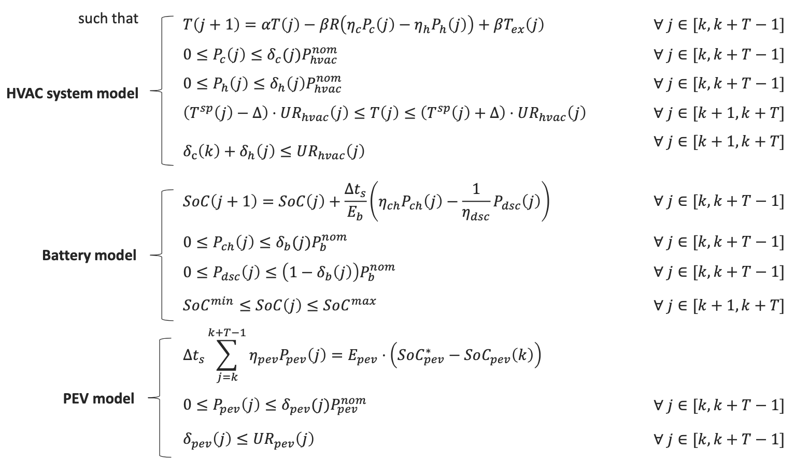
Problem definition
Constraints
Simplified room model for air temperature regulation (heating & cooling).
A PEVs is a deferrable load. Ppev is maximum re-charging power.
‘ Coulumb counting’ BESS dynamic model included charging and discharging modes.

Slide 18
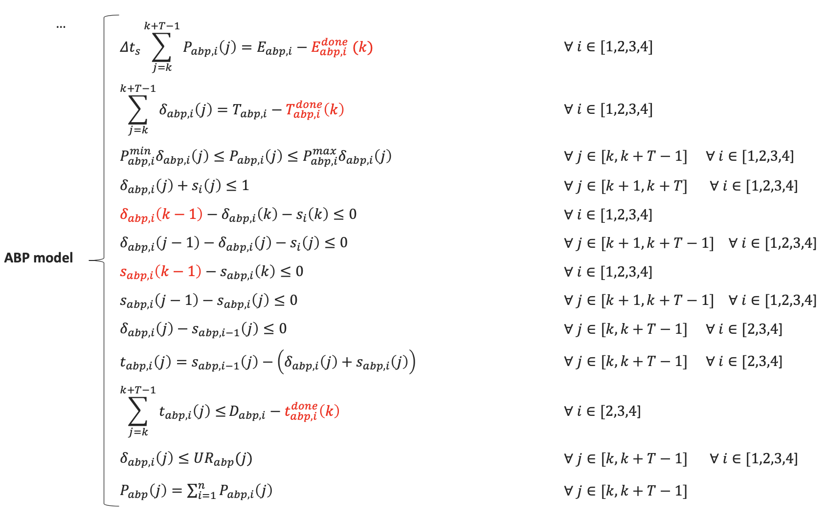
Problem definition
Constraints
Required energy, execution time, power limits, order and non-interruption of phases, maximum delay between consecutive phases constraints of an ABP model. Red quantities are parameters.

Slide 19
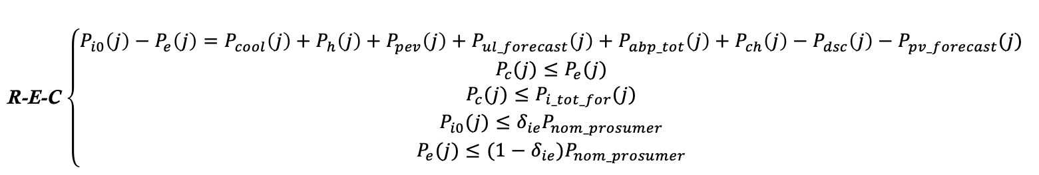
Problem definition
Constraints
The first constraint is strictly related to prosumers energy consume and production.
In this case, we consider positive all the quantity imported by the grid and negative otherwise
Once there is only one prosumer, obviously the entire energy shared must be <= to the total amount of energy exported by producer itself an, at the some time, <= to the total amount of consumers forecasted.
On the other hand, we introduce the variable δie imply self consumption by prosumer of the generated energy.

Slide 20
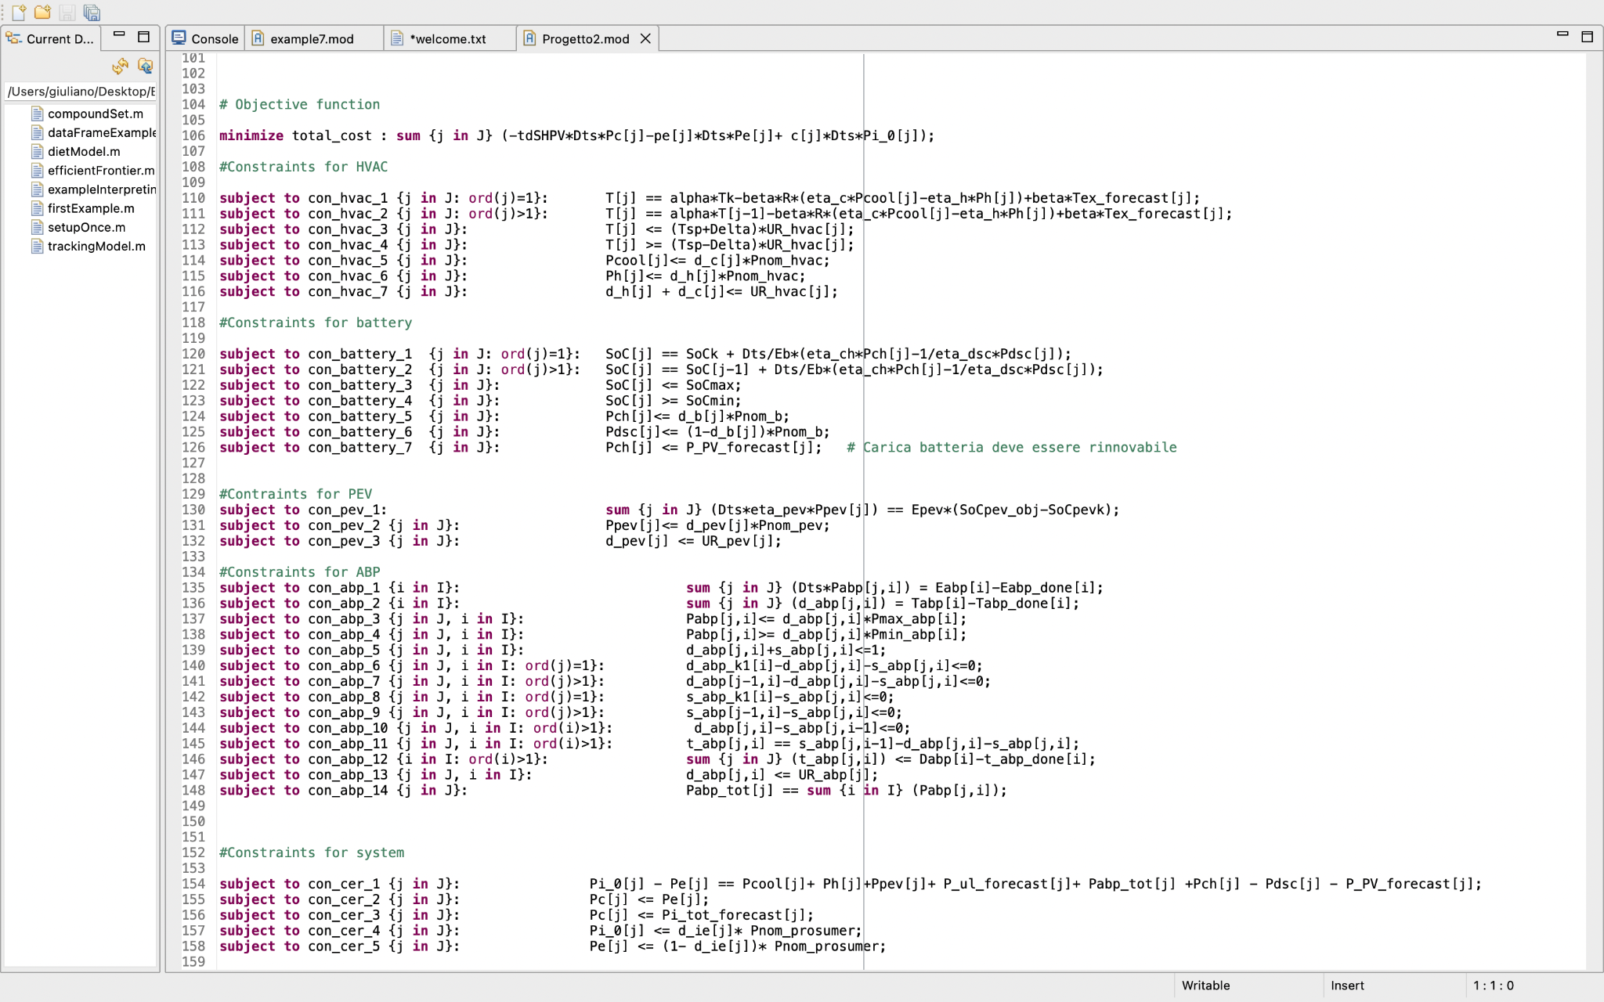
Problem definition
AMPL implementation
Mixed-integer Model Predictive Control (MPC) problem
CPLEX solver used
Receding horizon principle adopted

Slide 21
03
Results
3 days - 7 days simulations with and without considering a BESS usage

Slide 22
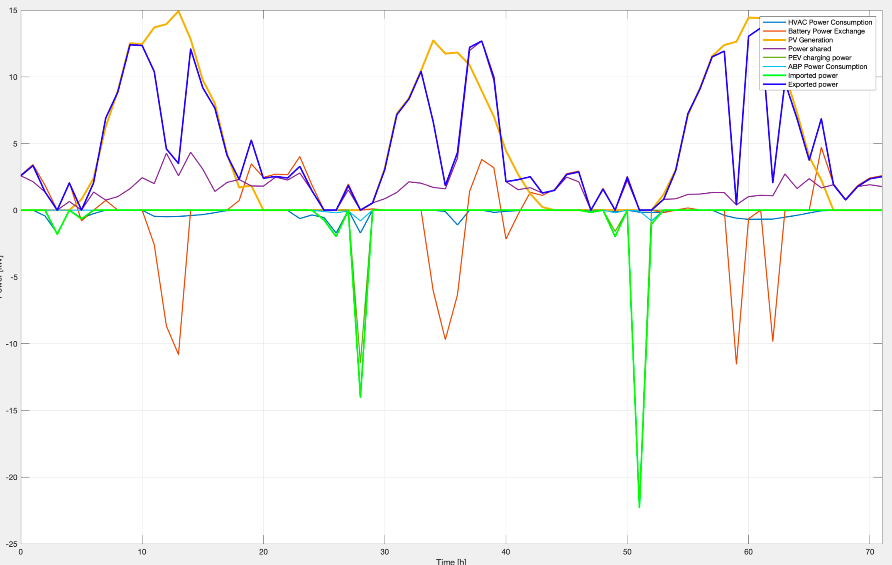
Results
3 days simulation 15-17 June
We can see how exported power by prosumer is strictly related with PV plant generation and, sometimes, with battery discharge.
Otherwise, importing power is necessary when there isn’t it.
Finally, battery helping results very important when consumers load increase, export decrease and so this contribution improve power sharing and exporting.
NB: Pch is negative, Pdsc positive.

Slide 23
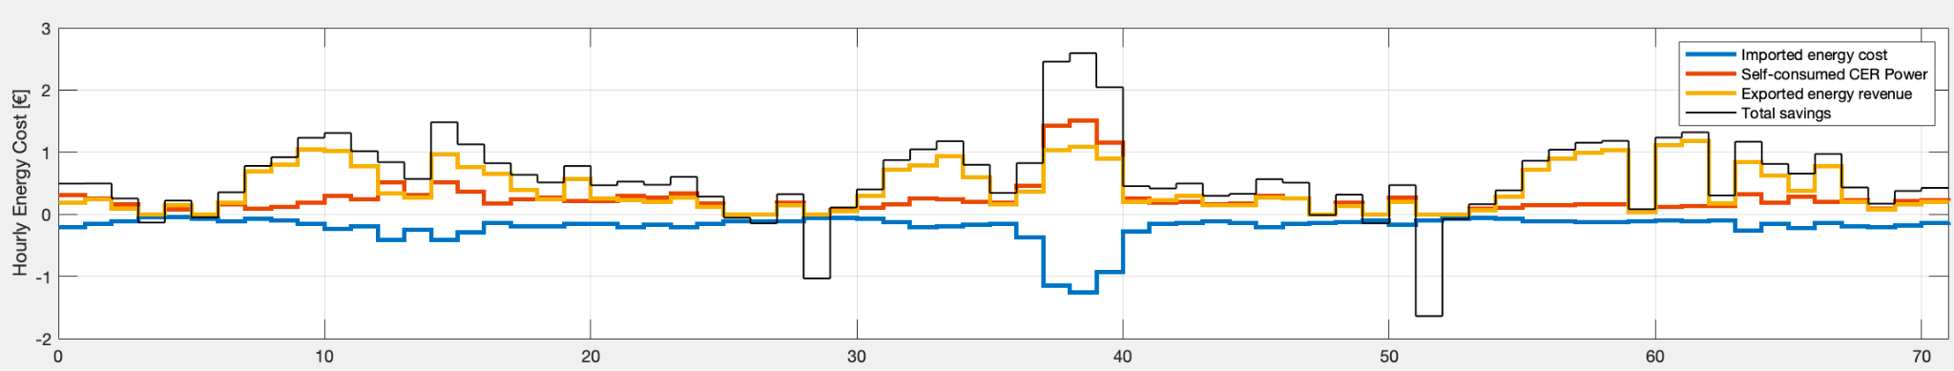
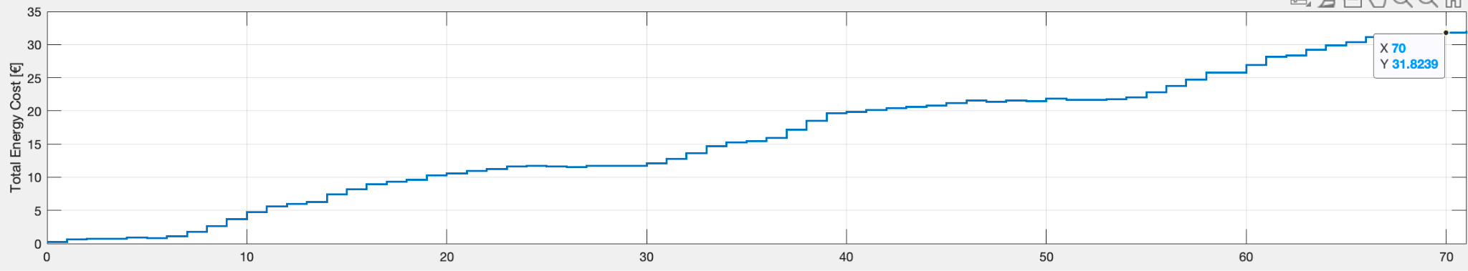
Results
3 days simulation 15-17 June
From an economic perspective, we register an income of 31 € , in only three days , from exporting and sharing Power less cost energy imported. From (2) we can see that total savings increase and contrast imported energy cost thanks to self-consumed CER power incentives.

Slide 24
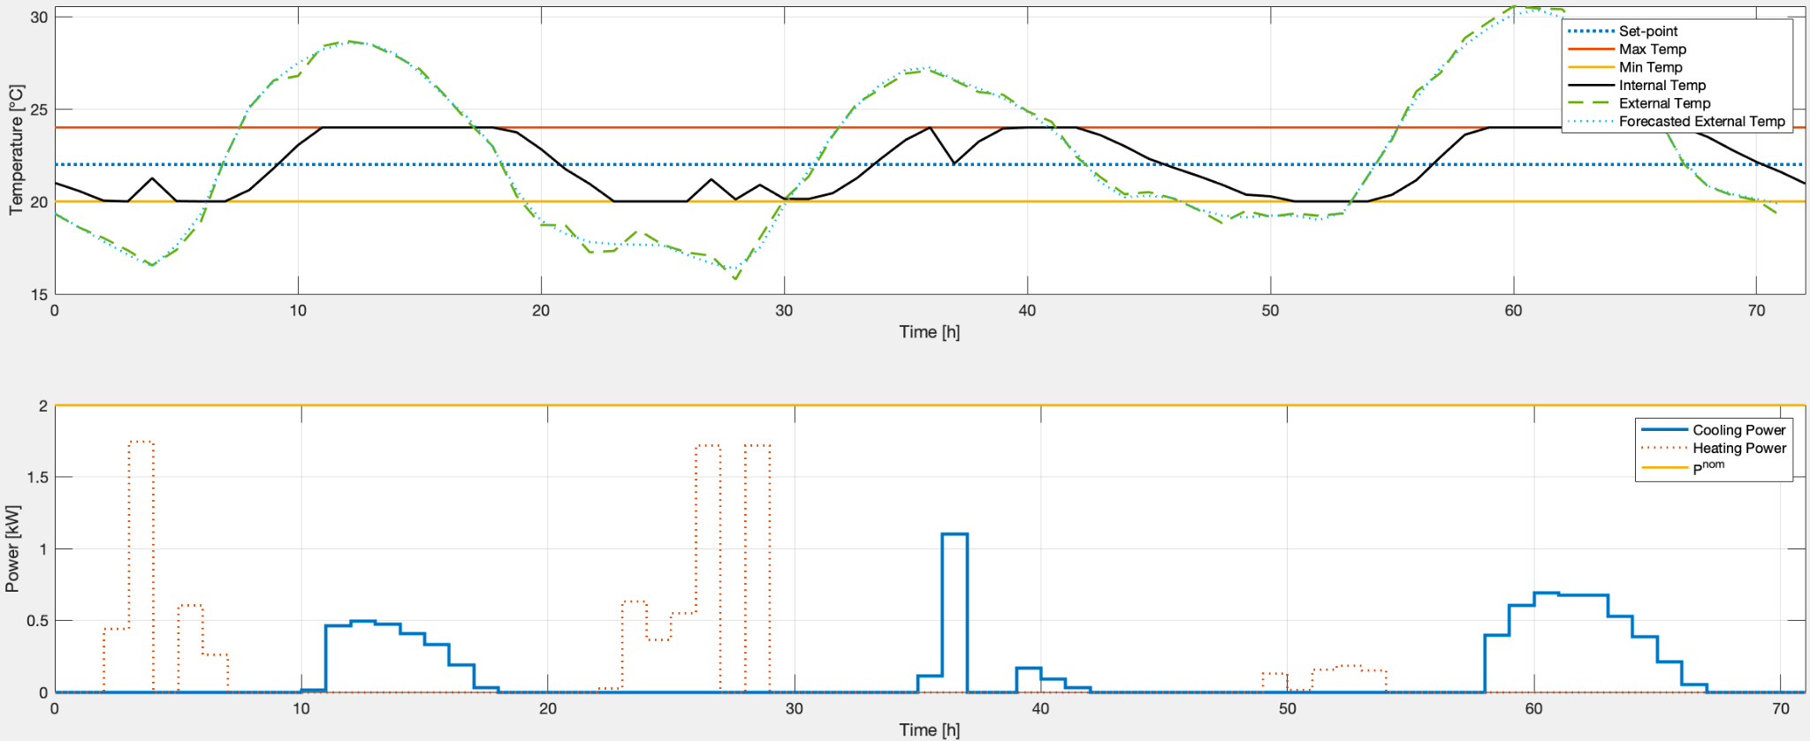
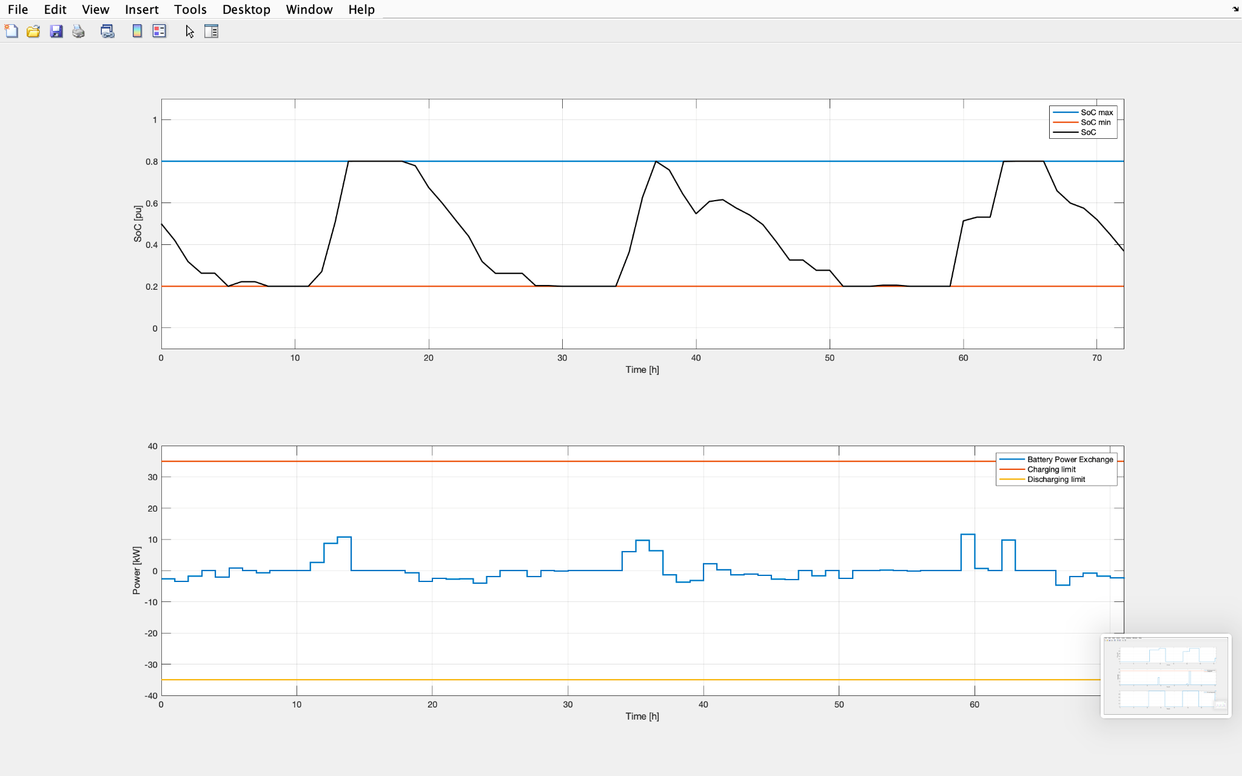
Results
3 days simulation 15-17 June
In the figure (1), it’s reported Temperature profile and resulting Cooling and Heating power consumption used to maintained the set point in the required range
Meanwhile, in (2) we find the battery State of Charge profile , kept in the range, and charging less discharging power difference trend.

Slide 25
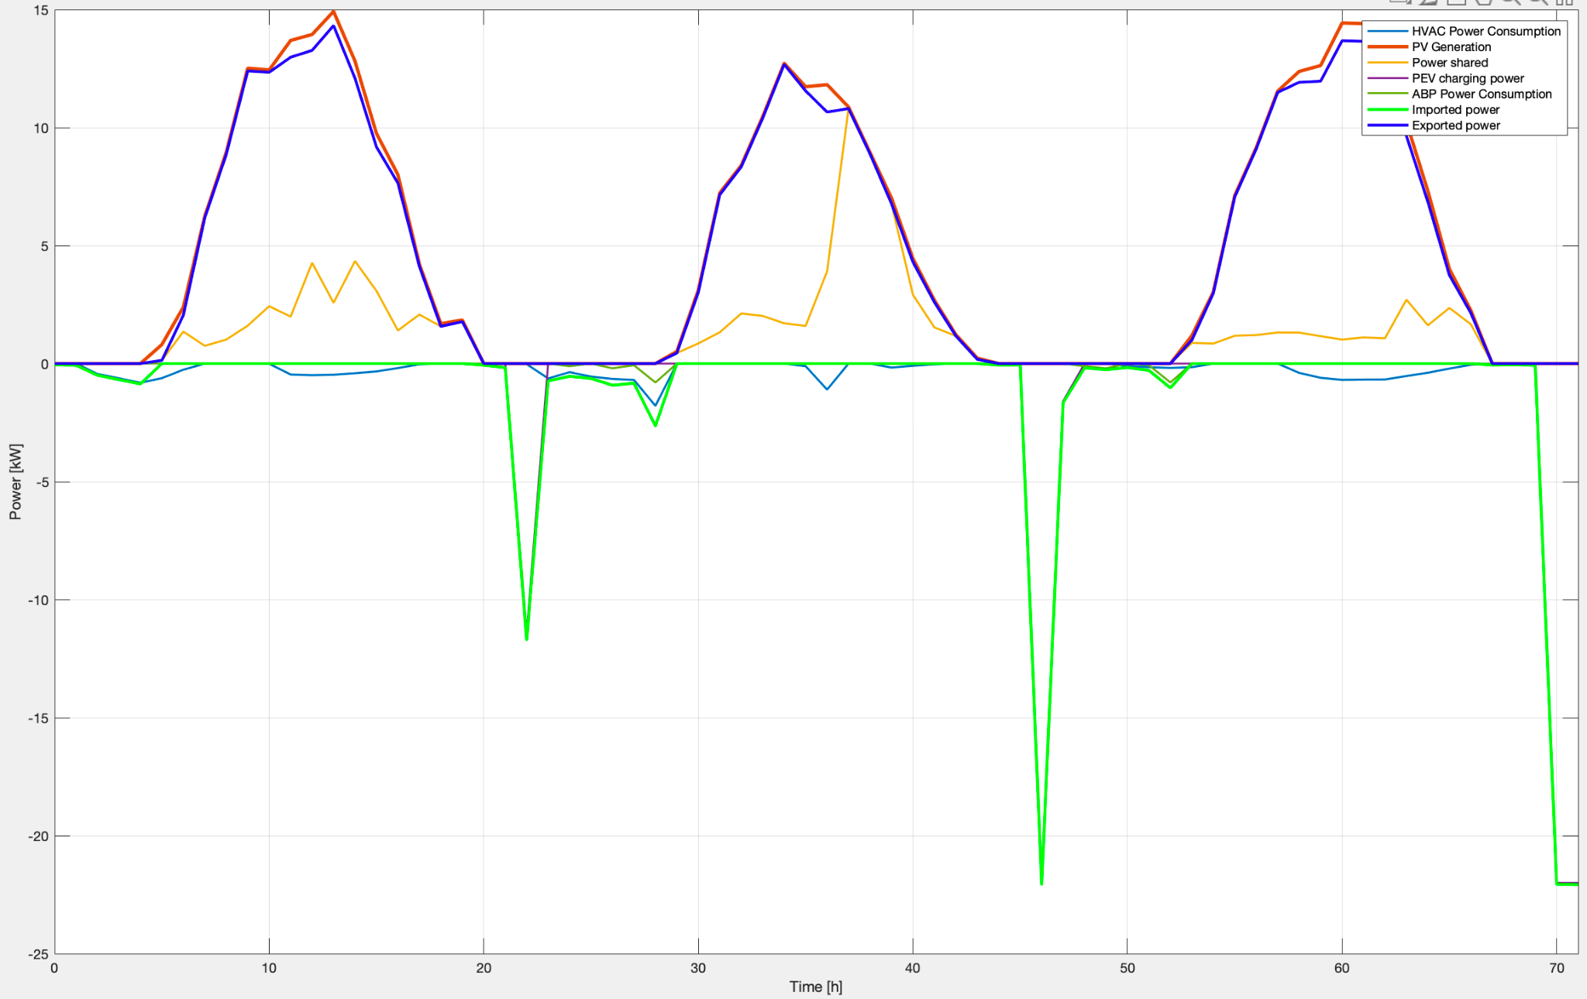
Results
3 days simulation no battery 15-17 June
Since battery rule, we perform a 3 days simulation without it.
In this case, all the power exported is <= to PV plant generation.
A third imported power peak emerges respect the previous case.

Slide 26
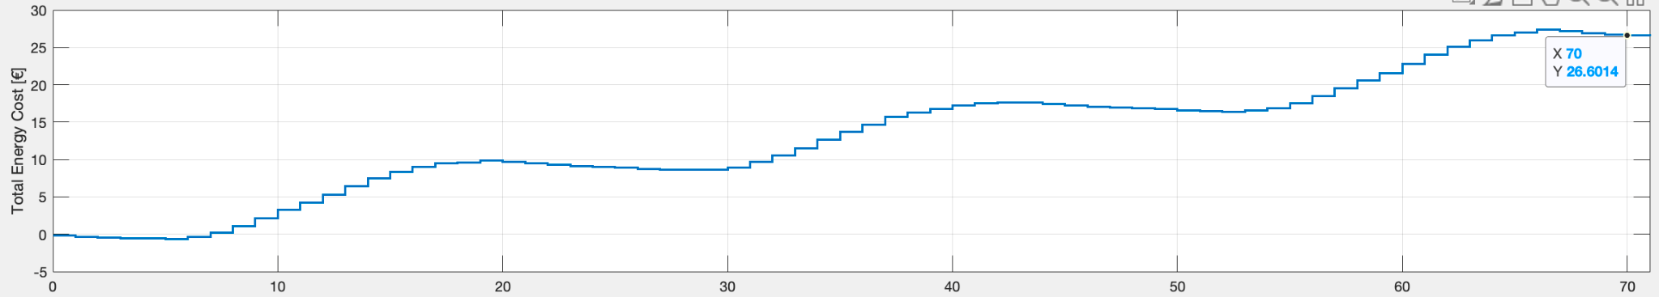
Results
3 days simulation no battery
15-17 June
It’s evident an income loss of 16,4%, due to battery absence. Furthermore, actual cost curve presents a smooth trend respect the previous. Indeed, it increases only during daily hours when solar radiation is present.
Temperature, Pheat and Pcool profiles remain the same.

Slide 27
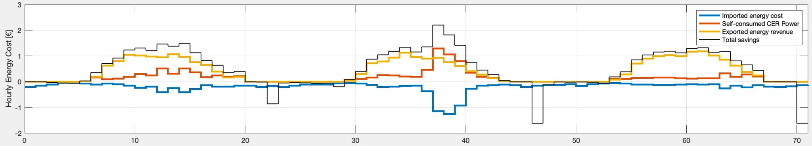
Results
3 days simulation no battery
15-17 June
On the top, we have hourly energy cost trends without battery use; on the bottom, the previous case. In a roughly analysis, total savings curve presents more less positive values and peaks, in particular a larger area. In the figures, it emerges that battery use improve the presence of shared power.

Slide 28
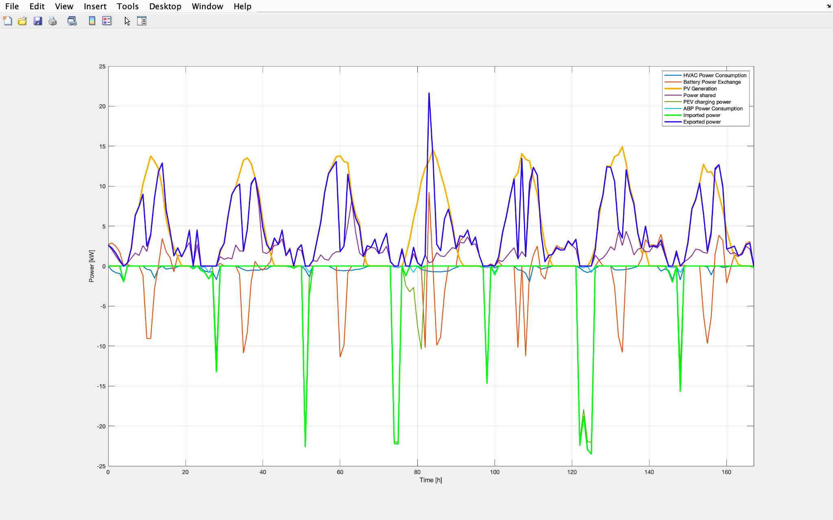
Results
7 days simulation
10-16 June
This long period term permits to highlight previous considerations.
First of all, it emerges a constantly use of BESS that enables more exporting power respect to PV plant generation, within more convenient hours, so producing an important shared power trend and major income. On the other hand, the BESS alone can’t provide the PEV requests during night hours. This produces various substantial imported power peaks.

Slide 29
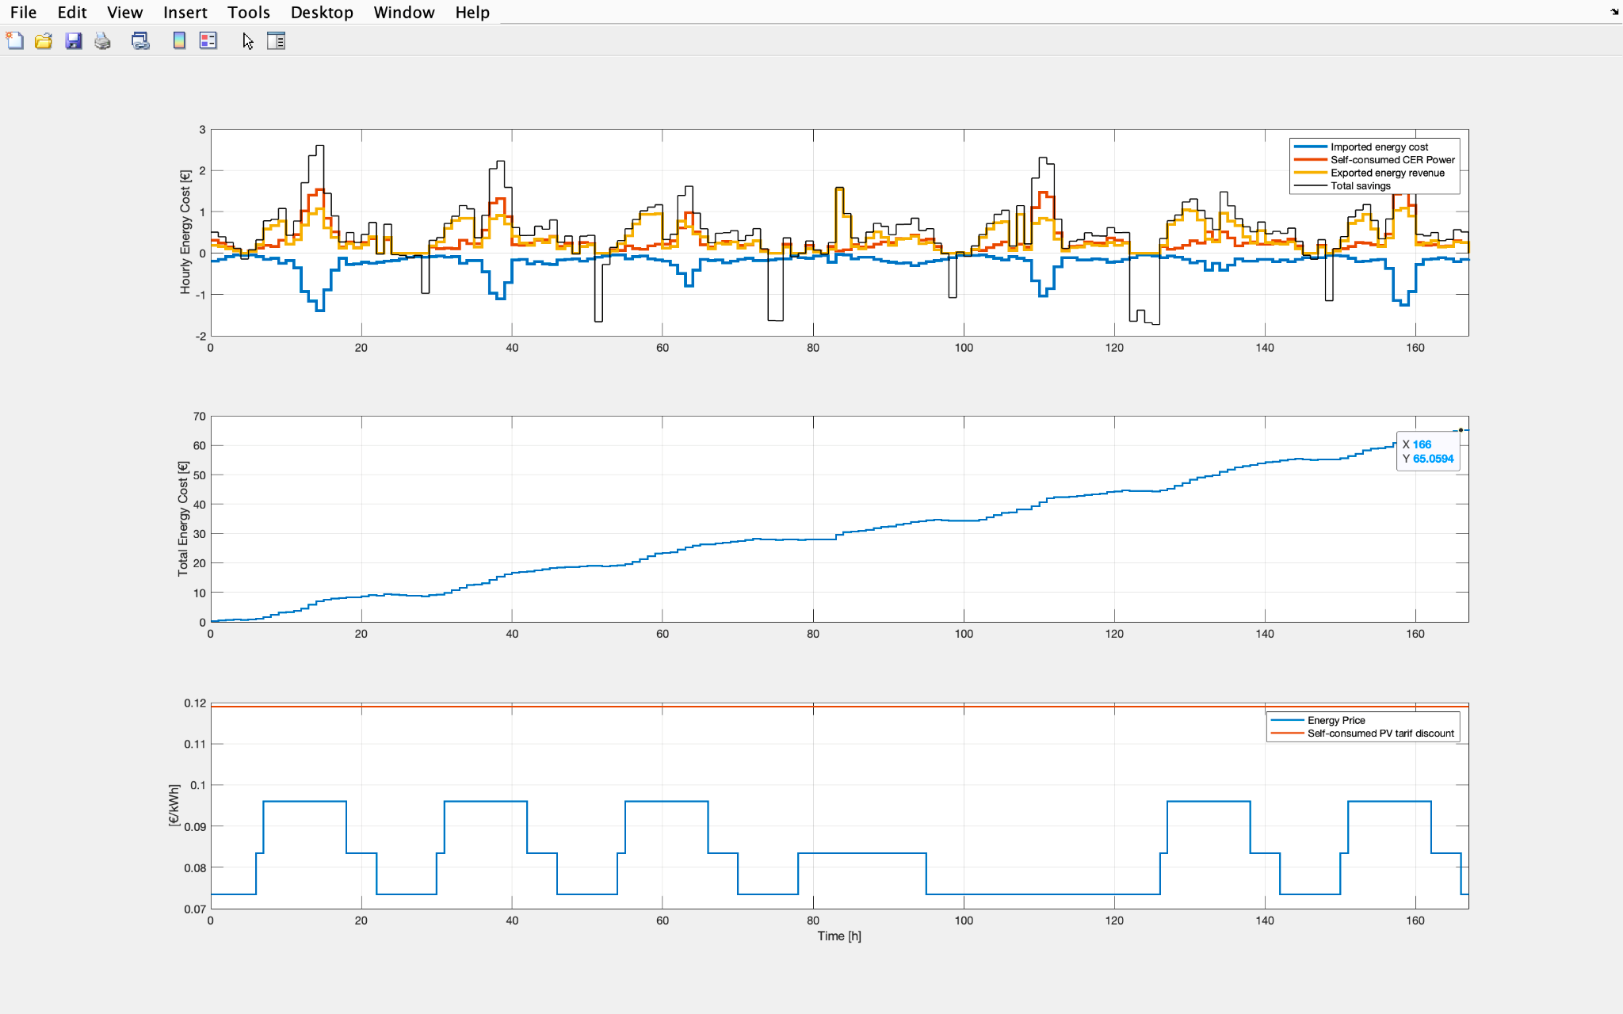
Results
7 days simulation
10-16 June
It’s noticeable that with flow time the total income increase thanks to a consistent power sharing in CER. In 7 days it reach 65 Euro, in according to 3 days trend, but it could be higher if PEV power import was managed differently.

Slide 30
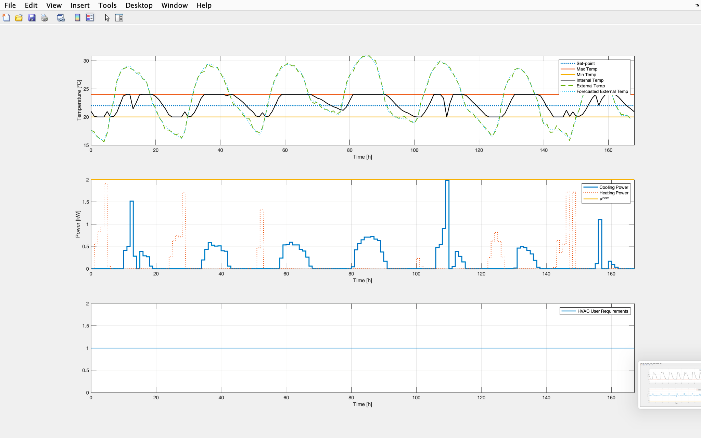
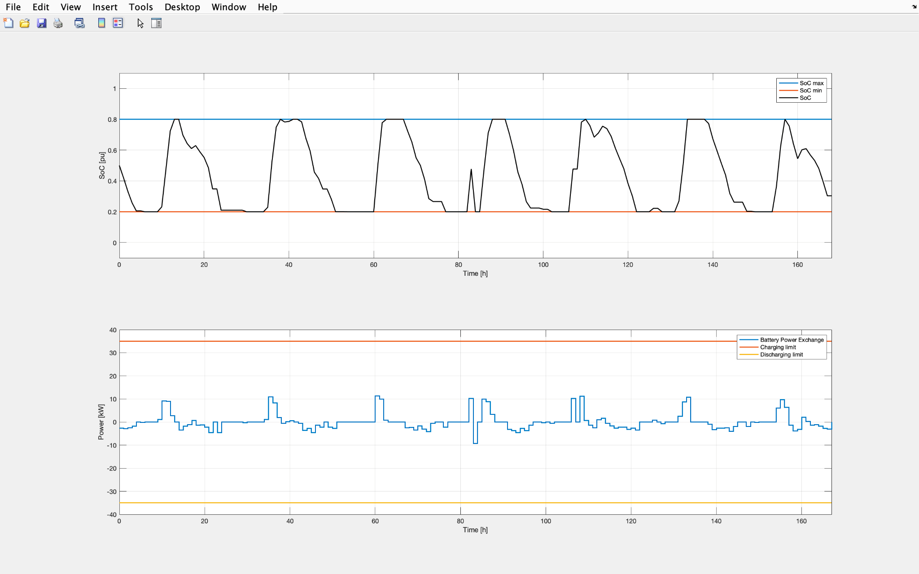
Results
7 days simulation
10-16 June
Varying days number of simulation, external temperature changes affect internal temperature profile.
Furthermore, high daily and nighttime ext temperatures make, respectively, PCool e Pheat nominal values.
BESS, regularly, alterns charge and discharge cycles; except one time, when, maybe, it was convenient, in terms of total income, an incomplete charge followed by a discharge.

Slide 31
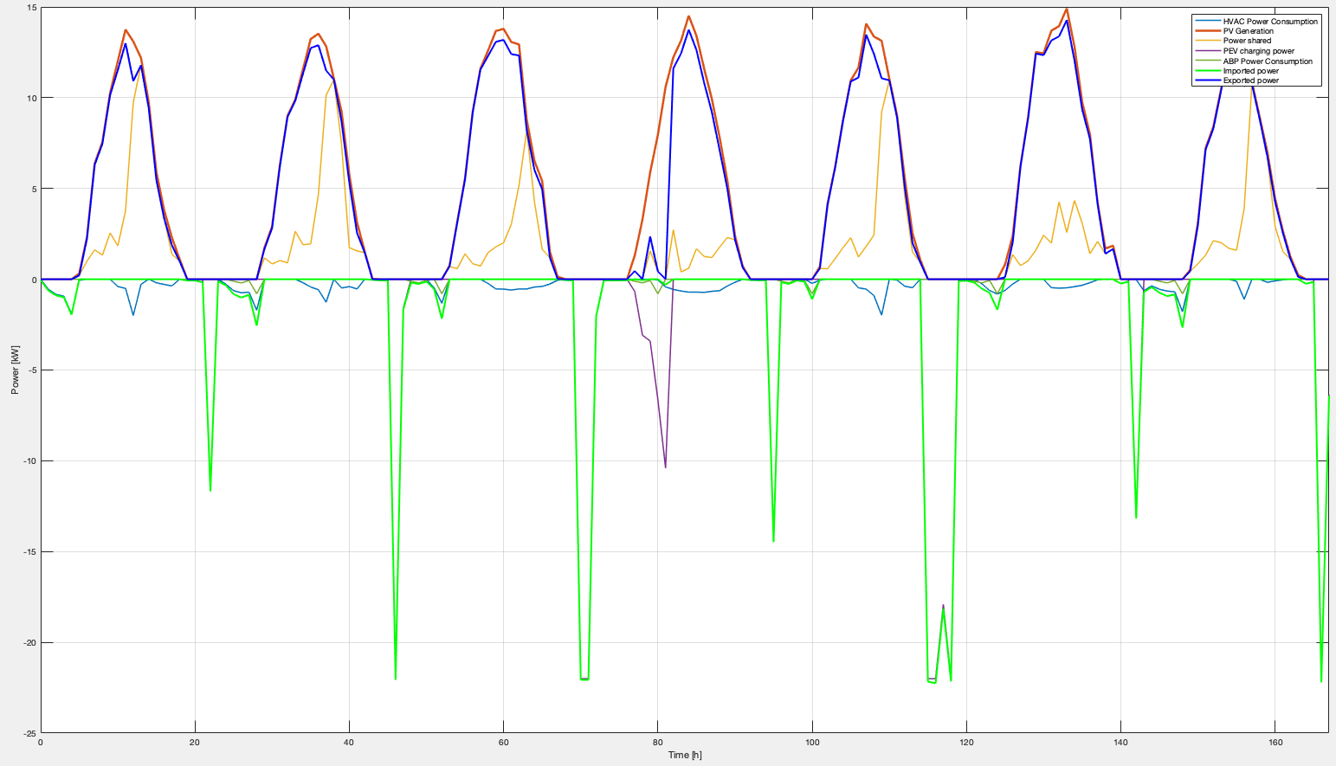
Results
7 days simulation no battery
10-16 June
As precedent comparison without BESS, exported and shared energy are strictly related to Pv plant generation.
This implies their total absence during nighttime hours.

Slide 32
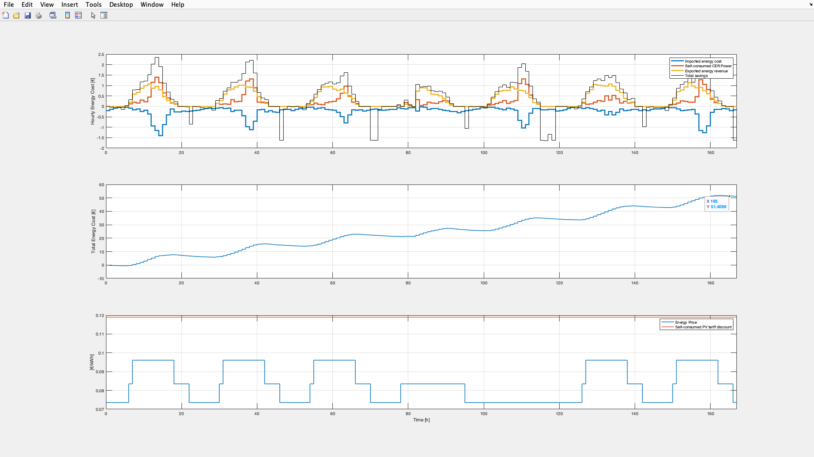
Results
7 days simulation no battery
10-16 June
Without BESS, as said before, during nightly hours there isn’t power export from prosumer, so neither sharing. This situation implies a lower total income; indeed, in this period, we register a 25,1% total loss. Again, the curve trend is smooth, with increases , due to PV plant generation, only during daily hours.

Slide 33
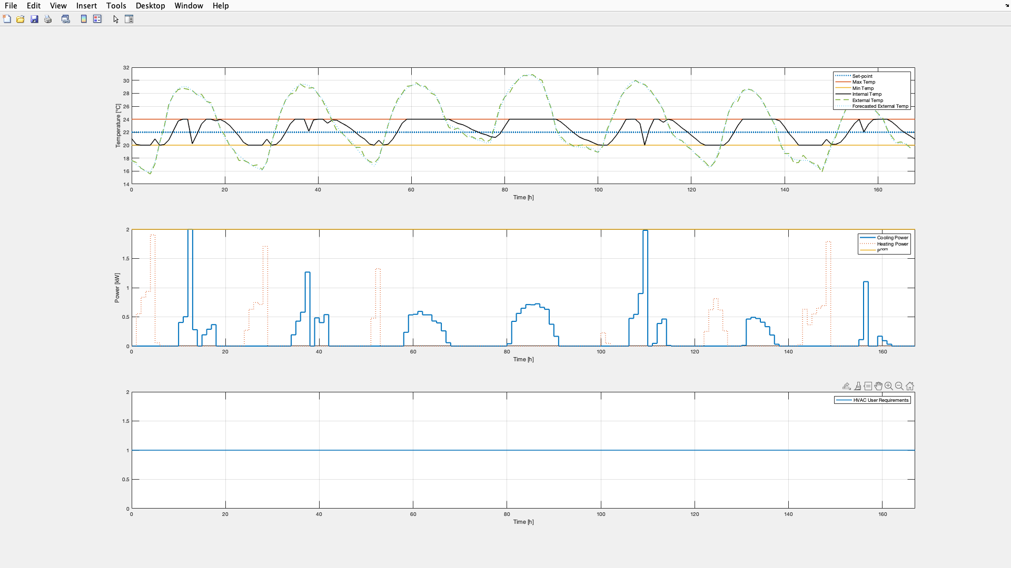
Results
7 days simulation no battery
10-16 June
In this case, we register different internal temperature, always in required range, PCool and Pheat profiles. In particular, without a BESS, it’s noticeable the presence of different peaks close to nominal values.

Slide 34
04
Business
case

Slide 35
Economic feasibility
In further consideration, we assume an initial self-investment by CER members equally distributed.
For the calculation of IRR, annual cash flows were considered; the estimate on annual revenue is based on the weekly revenue obtained in the simulation on pag 29 .
This result was then scaled by a random factor reflecting: both the possibility of lower or higher generation than that obtained in recent week of June and a solar irradiation increasing due to climate change.
In addition, a 10% annual increase in generation was added assuming improved resource management and refinement of user behavior.

Slide 36
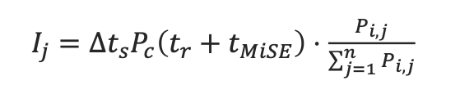
Economic feasibility
In fact, active user behavior was also assumed and the distribution of profits would occur according to an energetic criteria:
- the share related to the emitted energy (𝑃 ) is divided among all users according to the investment (thousandths, square meters, economic contribution);
- the share related to shared energy (𝑃) is divided proportionally to the load and thus to the relative contribution to the shared self-consumption:

Slide 37
Economic feasibility
Costs
REC foundation | 400 €
PV Plant | 29,000 €
Measurement device | 200 €/ Unit
BESS | 15000 €
PEV | 2009 €
Maintenance | 200 €/ Year
Administration | 400 €

Slide 38
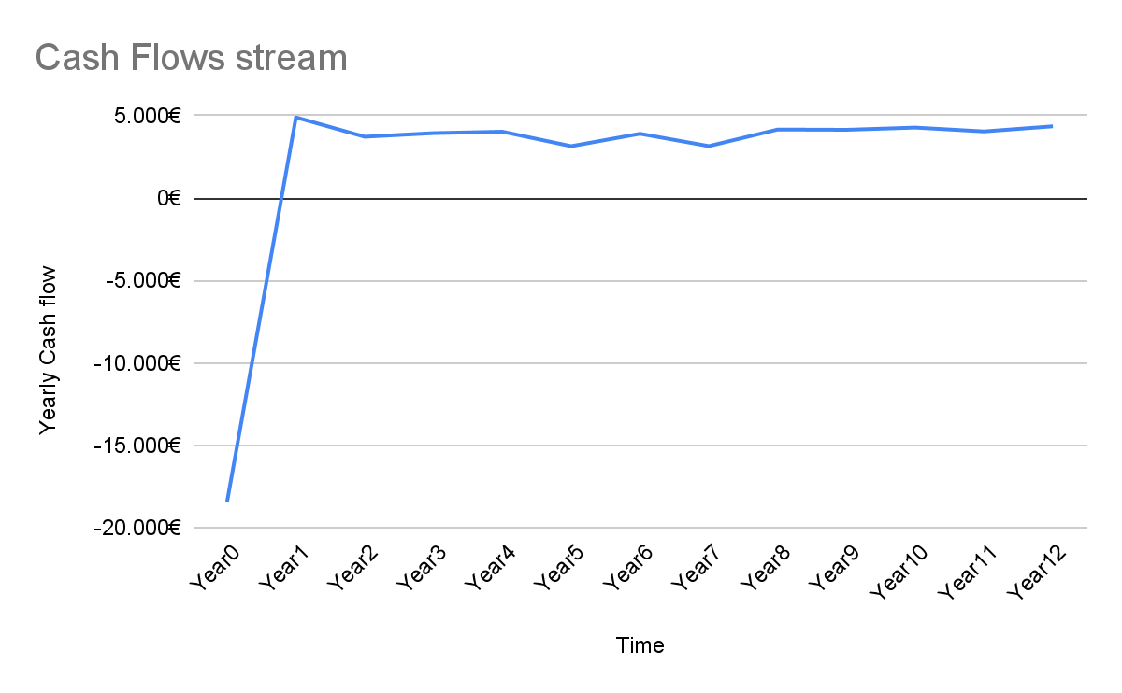


Economic feasibility
Income
Yearly CER income estimate | 3120,48 €
Fiscal Detration on PV Plant | 110%

Slide 39

Conclusions
Considering previous analysis, we can conclude that :
BESS use is suitable for CER efficiency and development.
Sharing power incentive (tmise) is a fundamental aspect of CER building and sustainability [This point will be fixed by Italian government within next CER normative, necessary for sector take-off]
The total income would have been higher if PEV had been present in one of 30 houses garage.
The positive trend in total gain is, of course, related to month days analyzed; it could have been lower, or even negative, if we had considered winter time periods.

Slide 40
Thanks!
Giuliano Salvati
Smart Systems Engineering student at Campus Biomedico University.
giuliano.salvati@alcampus.it
https://www.linkedin.com/in/giuliano-salvati-457a30205/
Code repo: https://github.com/giulianosalvati/Energycommunity

